Slide 1
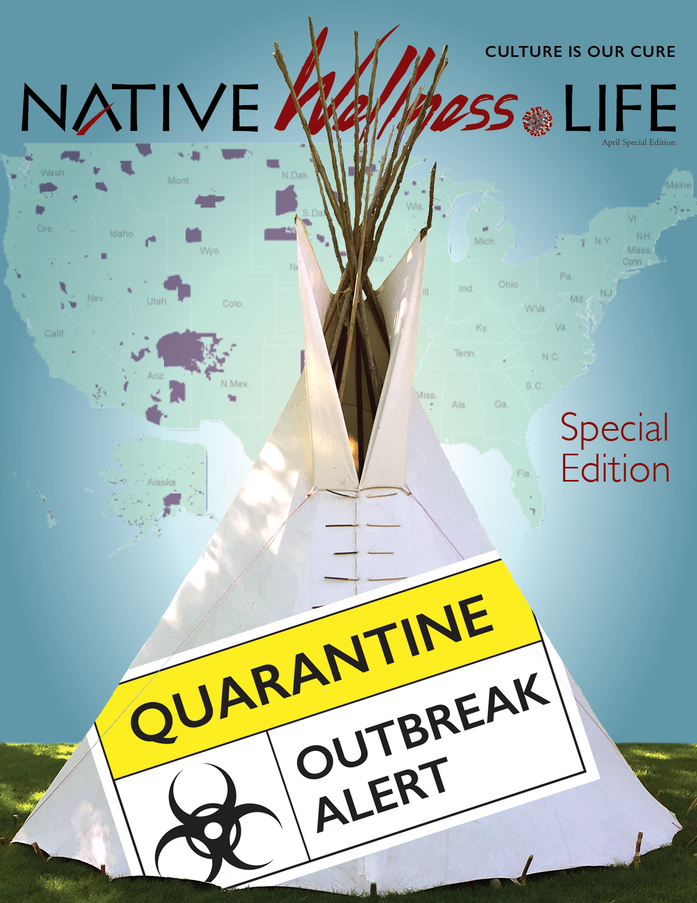
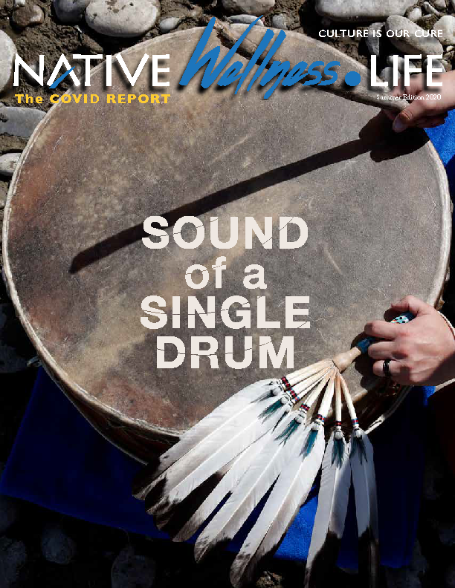
NativeWellness.Life
“The COVID Report”
COVID-19 prevention
is all we have to battle the virus
NativeWellness.Life, a publication made by Native Americans for Native Americans, is publishing its third special edition of “The COVID Report” in September.
Scheduled in the fall to warn about a second wave of the virus, it will emphasize the importance of wearing masks and social distancing.
Every day, scientists learn more about the virus and it’s not good news for the Native American community.
The COVID Report Special Edition was mailed out in May to 30,000 Native Americans.
The COVID Report Summer Edition was mailed out in June to 32,000 Native Americans.

Slide 2
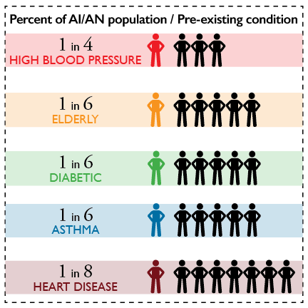
NativeWellness.Life
“The COVID Report”
The threat level for Native Americans has increased
Scientists say people with body mass indexes of 30 or more are at increased risk of getting COVID-19. This is startling because roughly two-thirds of American Indian and Alaska Native adults are overweight (CDC study).
2 out of 3
Native Americans
are overweight or
Obese (CDC)
COVID-19 targets Native Americans with these underlying conditions
COVID-19’s newest target: The overweight and obese

Slide 3
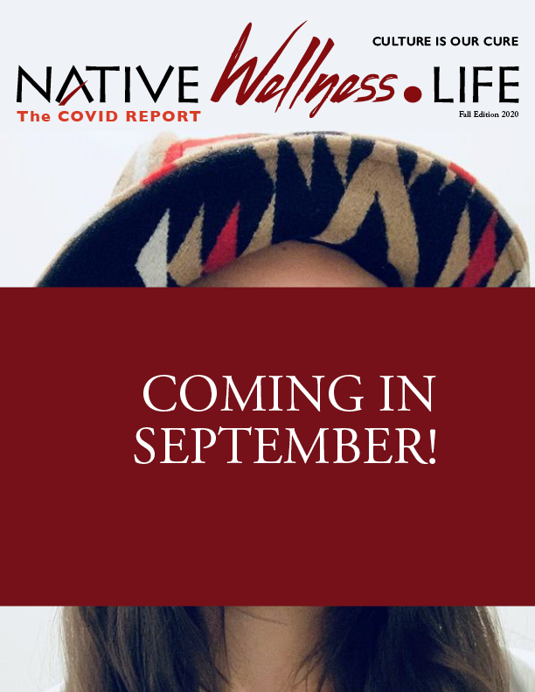
NativeWellness.Life
“The COVID Report”
What to expect in the next edition
Emphasize the wearing of masks and social distancing because prevention is the only tool we have against the virus.
We’re interviewing doctors about their concerns about how the virus is now targeting a greater number of Native Americans who are overweight/obese. This means the virus is now focusing on overweight kids, adults and elders. It’s not just a sickness that affects our senior population.
We’re highlighting tribal success stories about the virus. What are tribes doing right that others can emulate? How do we keep the rate of infection low?
Virus testing updates.
Tell the story of a native healthcare nurse and the challenges she faces every single day at work and at home.
Look back in history about how we think our ancestors would’ve handled this virus.

Slide 4
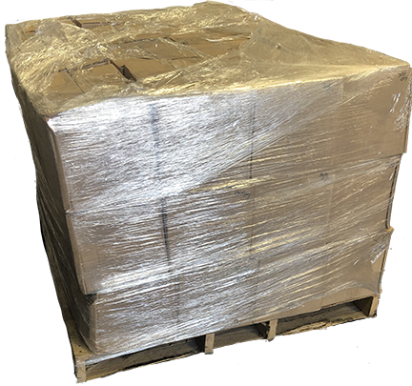
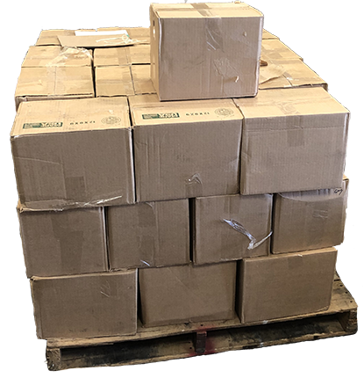
NativeWellness.Life
“The COVID Report”
Awareness Campaign
Who should buy “The COVID Report”?
The basic concept is to offer the magazine for free to tribal members. As such, the following organizations can combine their efforts to provide the magazine to their communities (we can face this threat together):
Tribal councils
Tribal colleges and schools
Tribal organizations & agencies
Hospitals/clinics
Wellness centers
Nonprofits
Urban Indian Centers
Food Distribution Program on Indian Reservations
Senior/Elder centers
Indian centers
How tribes are using them
Handing them out during virus testing
Staging them at different locations around the reservation and throughout urban communities
Delivering them to homes, especially to elders
Photo of freight shipment of 30,000 copies of The COVID Report arriving in Billings, MT

Slide 5
NativeWellness.Life
“The COVID Report”
1st Special Edition: Mailed in May to 30,000 American Indians who live in Montana. It warned everybody about the COVID-19, which was still very new at that time.
The COVID Report Summer edition: Again mailed to 30,000 and also mailed free boxes of 200 to tribes to hand out during COVID-19 testing in June. It reinforced virus prevention with moral support messages from the governor and tribal leaders.
The COVID Report Fall edition : Scheduled in the fall to warn about a second wave of the virus and its focus on the overweight and obese. It will emphasize the importance of wearing masks and social distancing, the only tools available at this time to battle the virus.
The COVID Report Winter edition : Scheduled in the winter when we’ll know more about the virus.
More editions can be created if needed.

Slide 6
NativeWellness.Life
“The COVID Report”
Awareness Campaign
Pricing
Cost will be $220 per box of 100.
That price includes shipping.
SPECIAL SAVINGS OFFER
SPECIAL $200 SAVINGS OFFER
Purchase 5 boxes and get the 6th box free (just add shipping and handling charges for that extra free box).
This cannot be combined with another organizations’ orders.
This means:
-- Buy 500 and get an extra 100 for free
-- Buy 1,000 and get an extra 200 for free
-- Buy 1,500 and get an extra 300 for free

Slide 7
NativeWellness.Life
“The COVID Report”
Awareness Campaign
For more information
Visit our website at https://www.nativewellness.life/
E-mail us
info@nativewellness.life
Call us toll free at
888-835-6419
We’d love to answer any questions you may have about “The Covid Report”
In addition, if you have a good story to tell, we’d be interested in hearing from you.
While we’re forced to hear the sound of a single drum for the time being, we’re still in this together.

